Slide 1

Selenium with Nunit (cont.)
Phung Ngo Viet Tien
October, 2022

Slide 2
Agenda
1. Optimizing Page Object Model
2. Web Object
3. Browser Factory
4. Driver Manager
5. Manage And Read Configurations
6. Data Driven Testing
7. Extend Report
8. QA

Slide 3
Optimizing Page Object Model

Slide 4
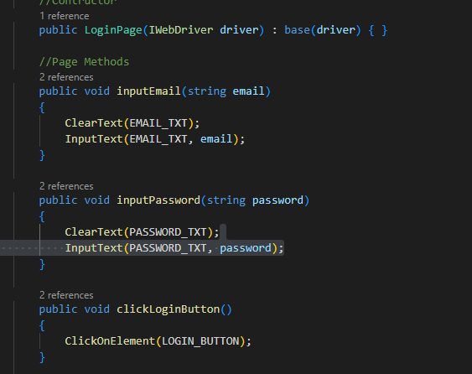
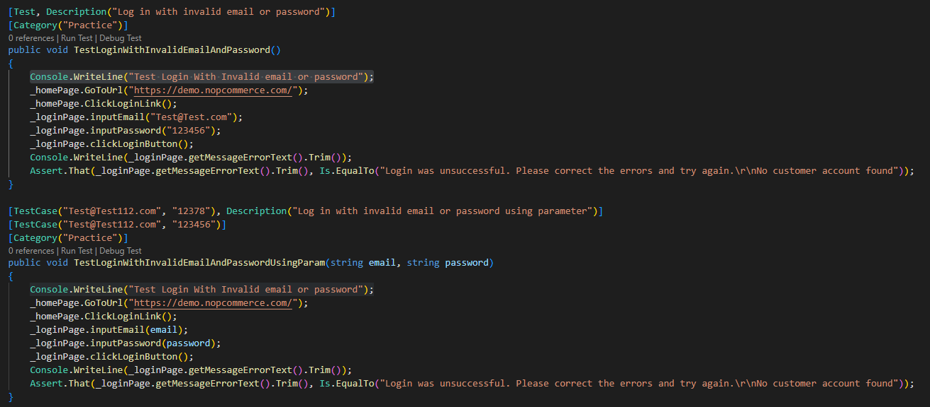
Binding Methods within the Page Object Model Class
The way to optimize Page Object Model or improving the test code is to wrap re-usable actions in the PageObject class itself.

Slide 5
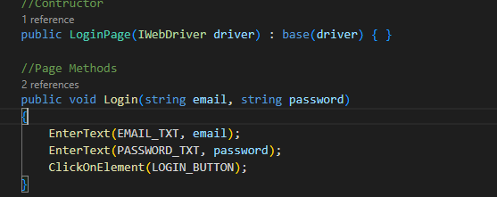
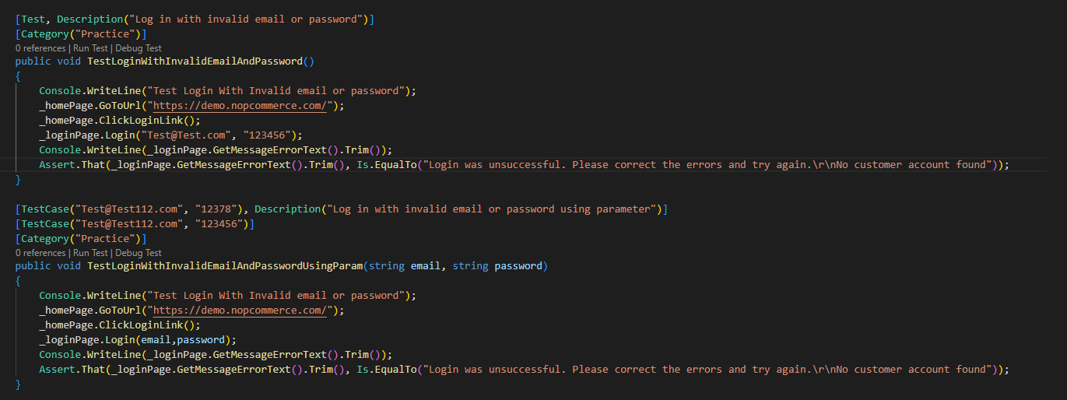
Binding Methods within the Page Object Model Class

Slide 6
Conclusion
Page Object Model make it easy to model web pages in Selenium and test them automatically and make the life of both developers and QCs much more simpler.
By abstracting away user interactions in your page object models and keeping your test routines light and simple, you can adapt your test suite to changing requirements with little effort.

Slide 7
Web Object

Slide 8
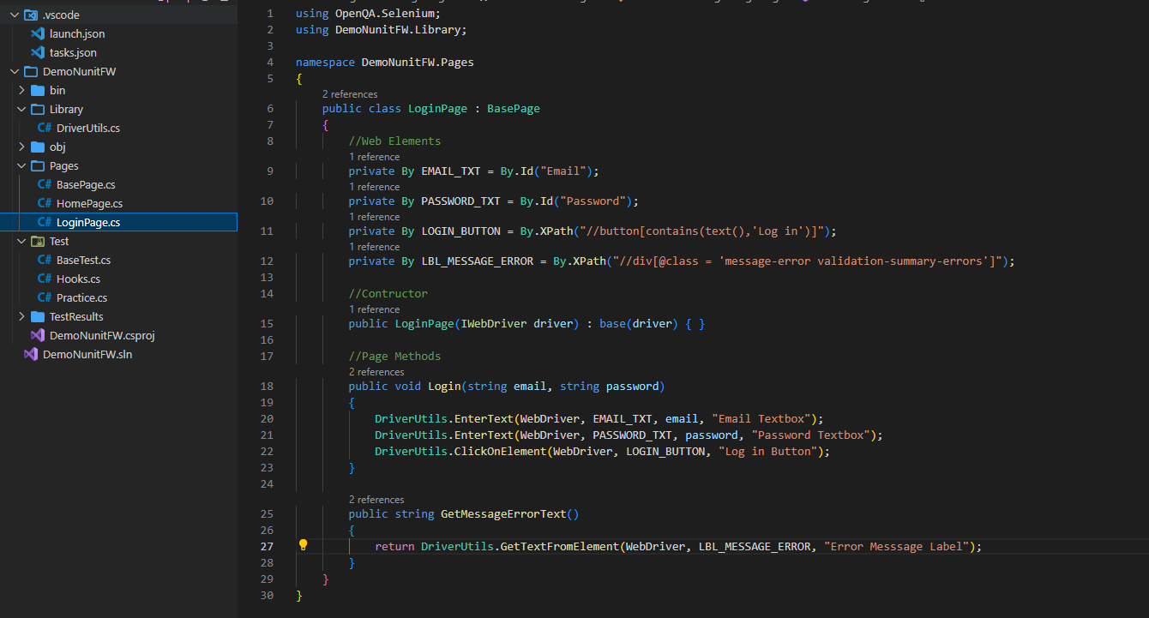
Web Object

Slide 9
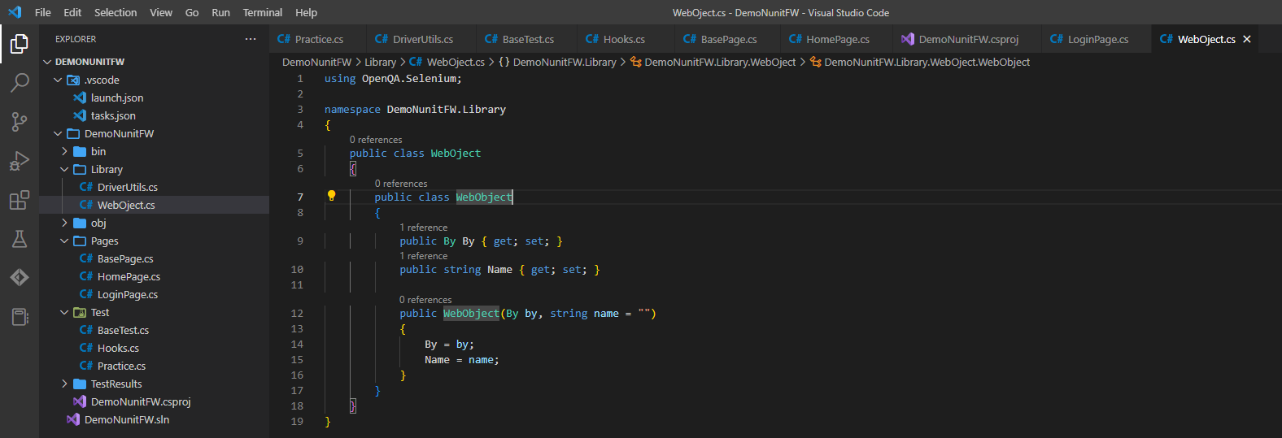
Web Object Class

Slide 10
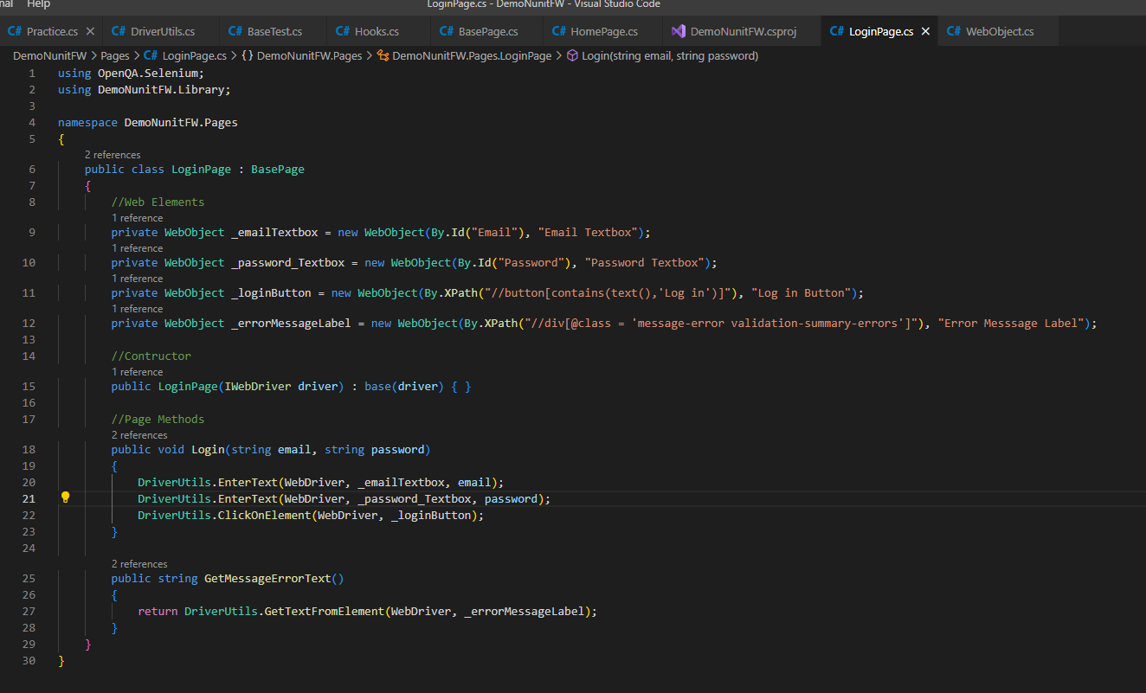
Update Page class

Slide 11
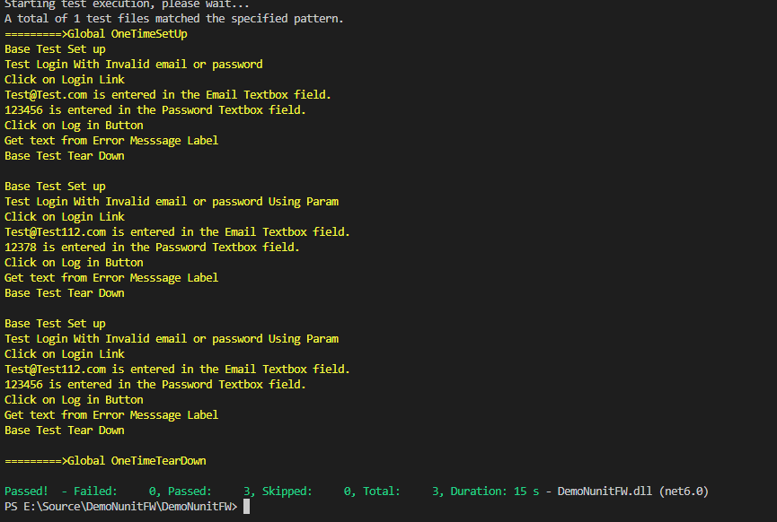
Result

Slide 12
Browser Factory

Slide 13
Factory Design Pattern
The factory design pattern is used when we have a superclass with multiple sub-classes and based on input, we need to return one of the sub-class. This pattern takes out the responsibility of the instantiation of a class from the client program to the factory class
A Factory pattern is used to encapsulate the complexity of creating an object. Below are the two important ideas behind Factory pattern:
Hide the logic of initializing an object inside the factory.
Refer to the object using a common interface instead of the concrete class.

Slide 14
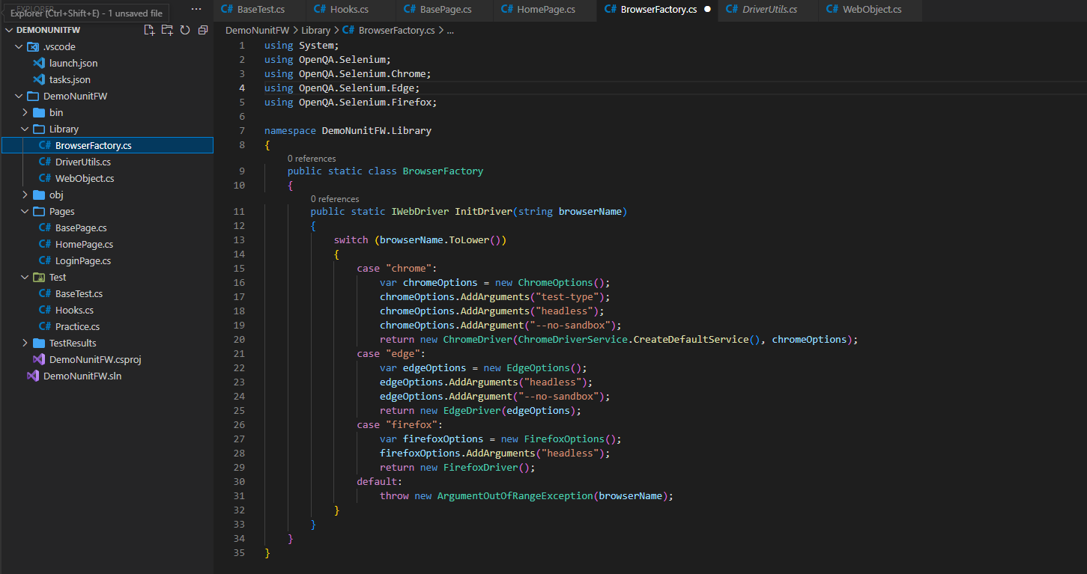
Implementation of Browser Factory

Slide 15
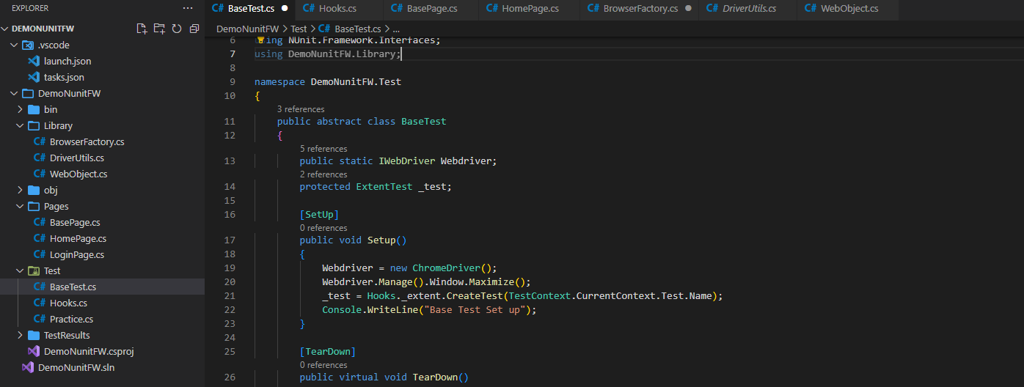
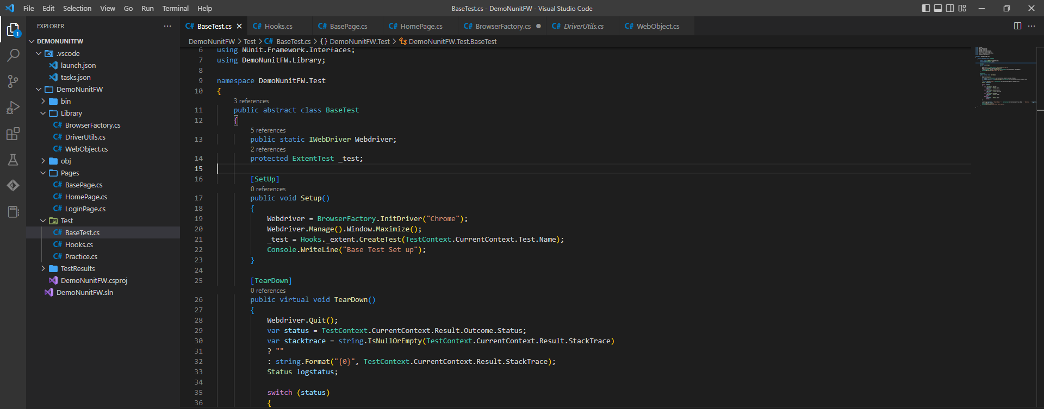

Slide 16
Driver Manager

Slide 17
Why we use Driver manager ?
WebDriverManager in Selenium is a class that allows us to download and set the browser driver binaries.
So a WebDriverManager class in Selenium:
automates the management of WebDriver binaries.
downloads the appropriate driver binaries, if not already present, into the local cache.
downloads the latest version of the browser binary, unless otherwise specified.
Eliminates the need to store driver binaries locally. We also need not maintain various versions of the binary driver files for different browsers.

Slide 18
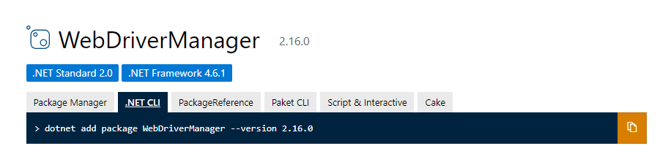
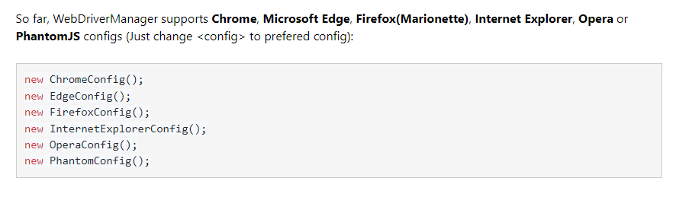
Installation of Driver manager

Slide 19
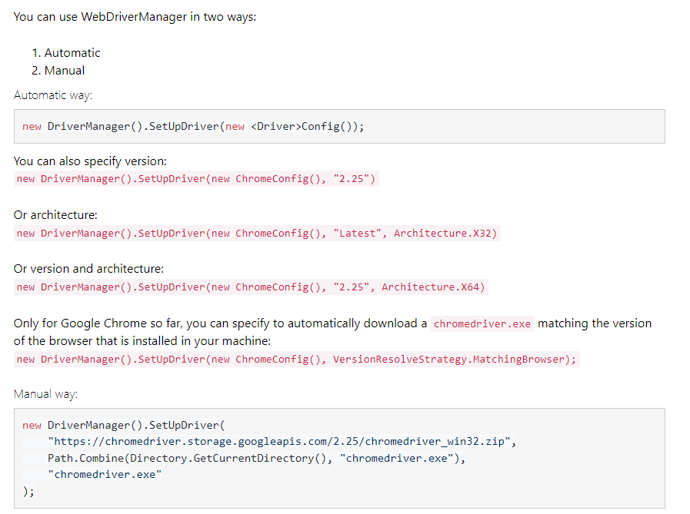
Usage

Slide 20
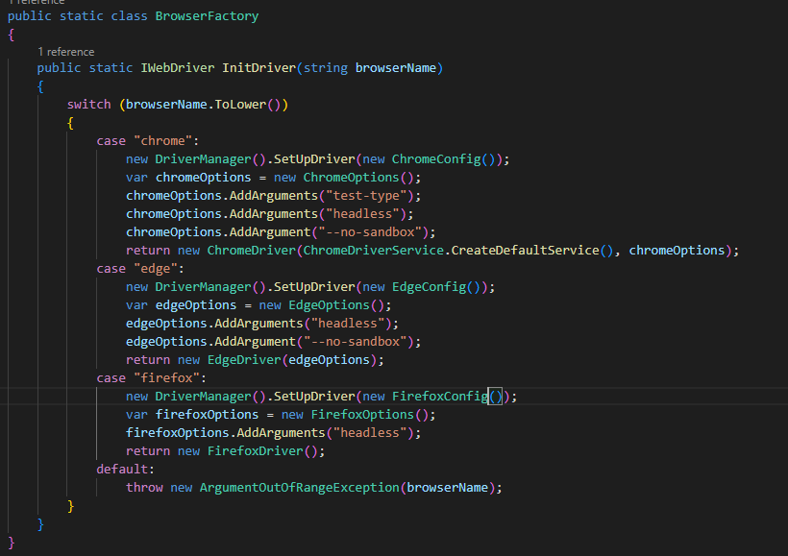
Implementation of Driver manager

Slide 21
Manage And Read Configurations

Slide 22
Context
We always use Urls, DB Connection String & Folder paths,… in any automation project. But when we design Frameworks, we should set the these data for once and use it many time. Whenever there is a situation to change in configurations just need to change the main configuration at one place.

Slide 23
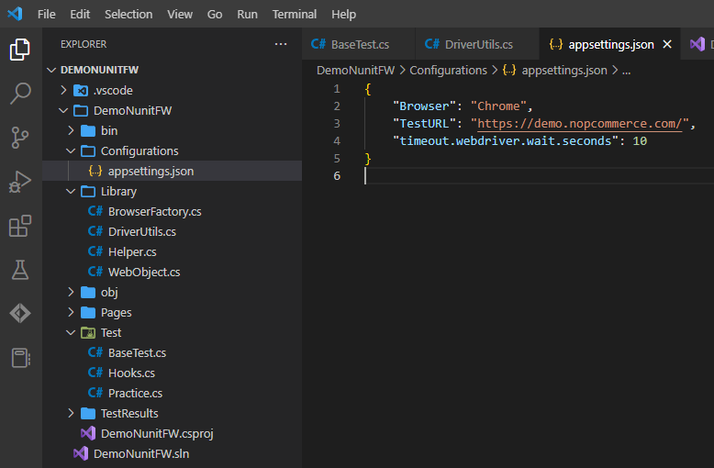
appsettings.json

Slide 24
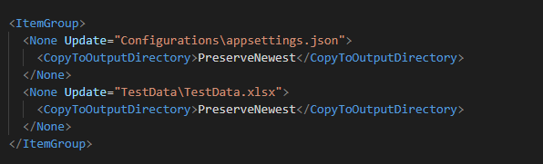
Copy appsettings.json file to Output Directory

Slide 25
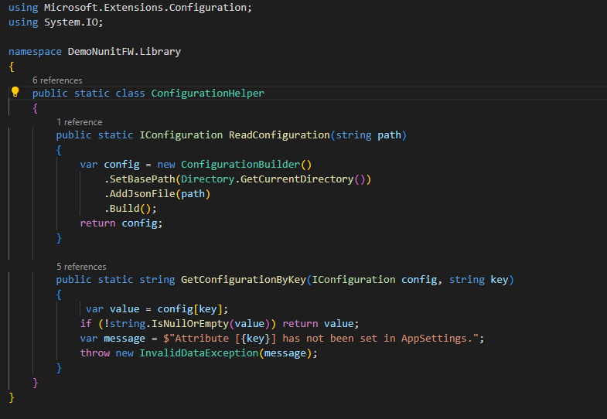
Create function to read and get value from appsettings file

Slide 26
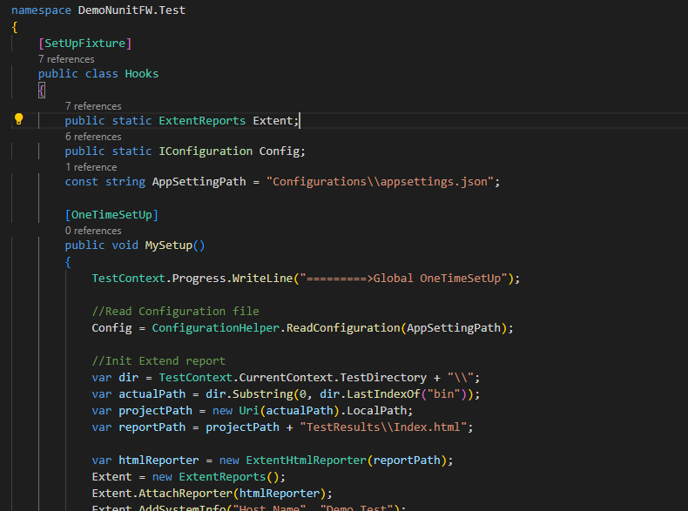
Read Configuration file before all test runs

Slide 27
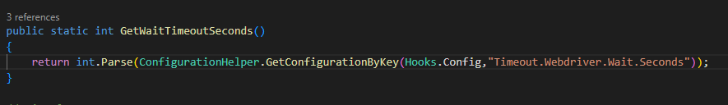
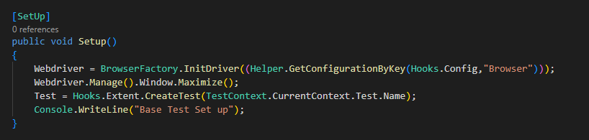
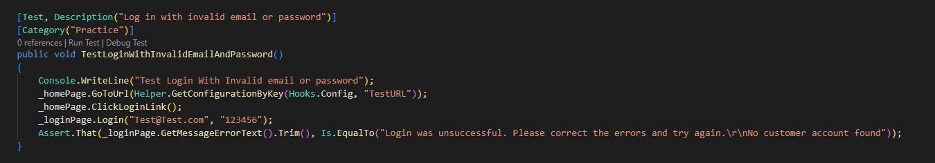
Usage

Slide 28
Data Driven Testing

Slide 29
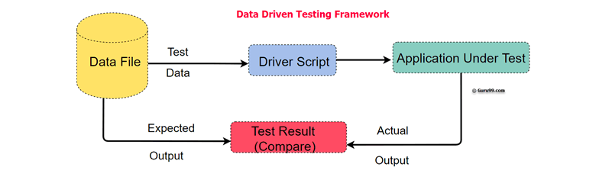
What is Data Driven Testing?
Data-Driven Testing is the creation of test scripts where test data and/or output values are read from data files instead of using the same hard-coded values each time the test runs. This way, testers can test how the application handles various inputs effectively.

Slide 30
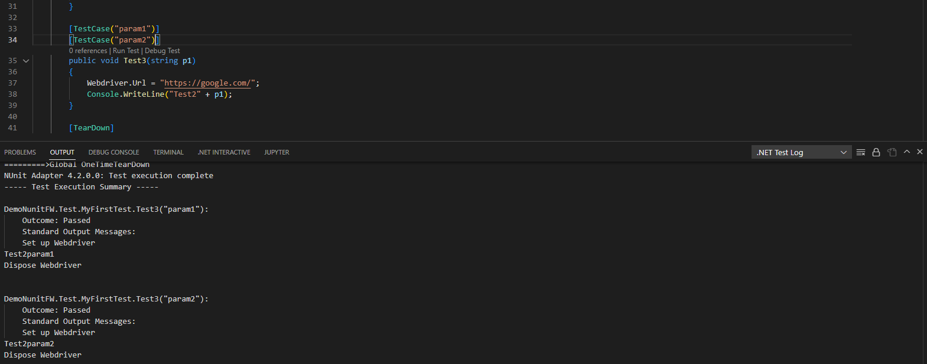
Test Case
TestCaseAttribute serves the dual purpose of marking a method with parameters as a test method and providing inline data to be used when invoking that method

Slide 31
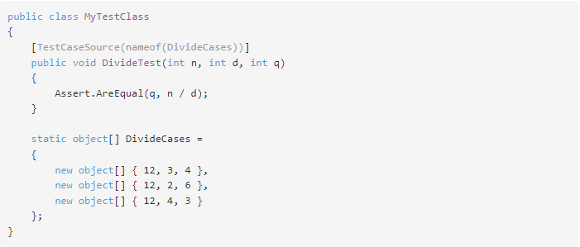
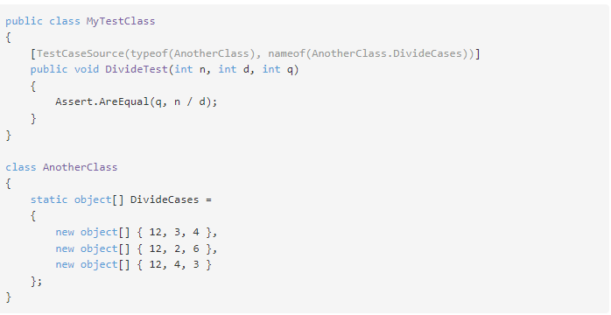
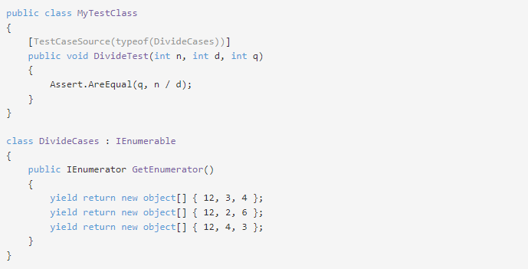
TestCaseSource
TestCaseSourceAttribute is used on a parameterized test method to identify the source from which the required arguments will be provided. The attribute additionally identifies the method as a test method. The data is kept separate from the test itself and may be used by multiple test methods.

Slide 32
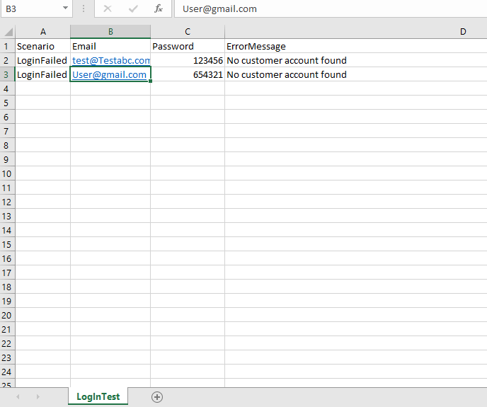
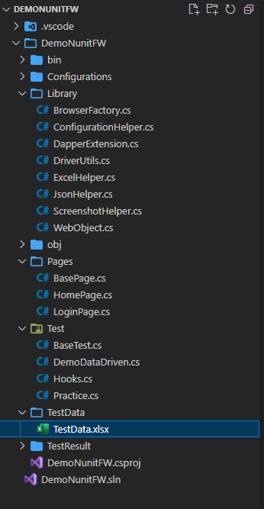
Selenium Data-Driven Testing Using Excel File

Slide 33
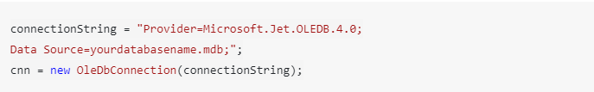
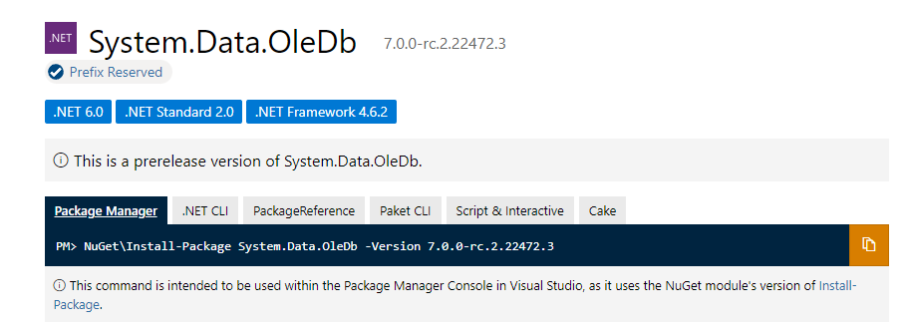
Read and Write Excel Using OLEDB
OLE DB is a COM-based application programming interface (API) for accessing data. OLE DB supports accessing data stored in any format (databases, spreadsheets, text files, and so on) for which an OLE DB provider is available. Each OLE DB provider exposes data from a particular type of data source (for example SQL Server databases, Microsoft Access databases, or Microsoft Excel spreadsheets).

Slide 34
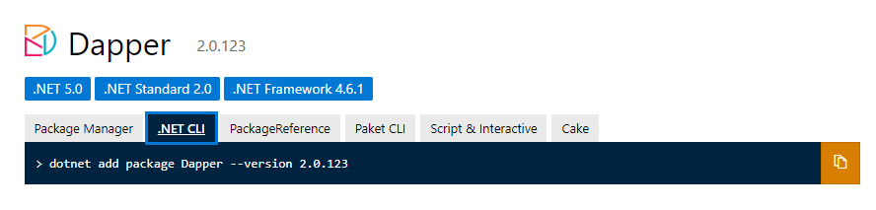
Dapper
Dapper is a high performance Micro-ORM(Micro Object Relational Mapper) supporting SQL Server, MySQL, Sqlite, SqlCE, Firebird etc.. It provides 3 helpers:
Execute a query and map the results to a strongly typed List
Execute a query and map it to a list of dynamic objects
Execute a Command that returns no results

Slide 35
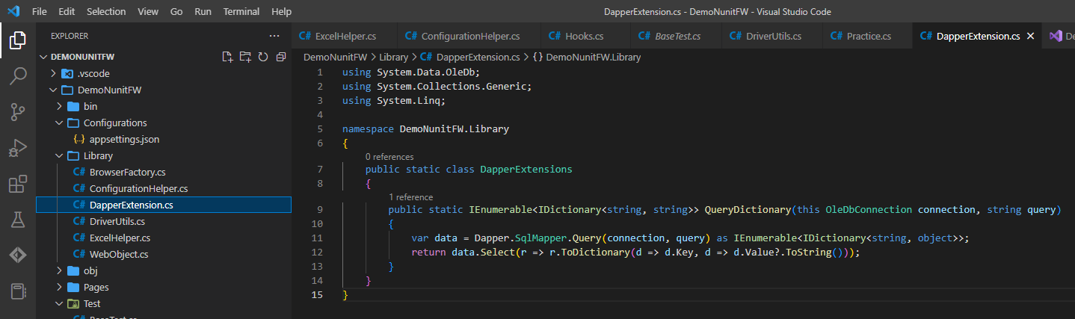
Create DapperExtension class to query and return data as a Dictionary

Slide 36
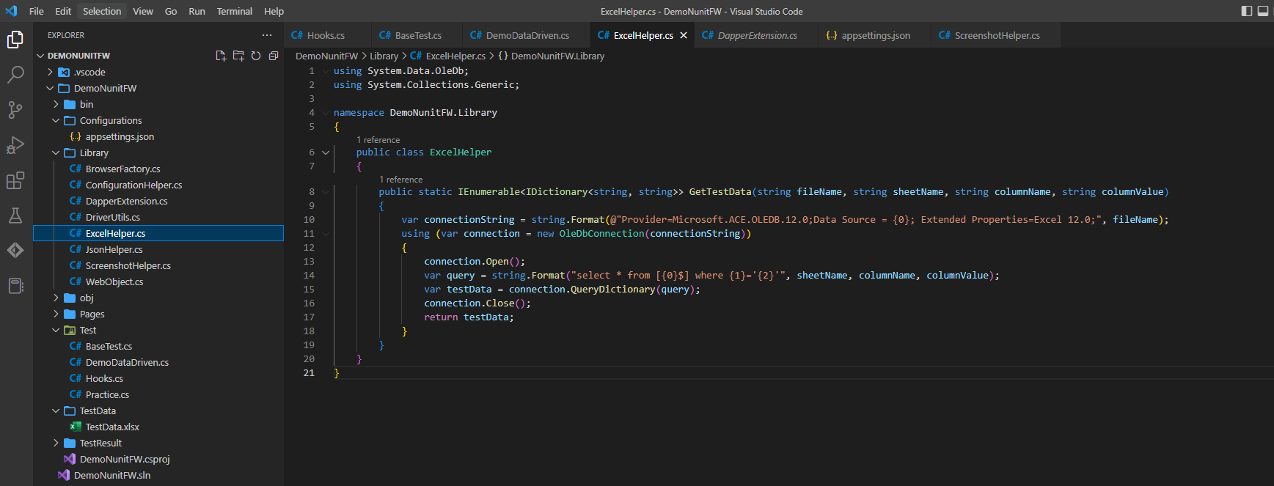
Create ExcelHelper class to read data from Excel file

Slide 37
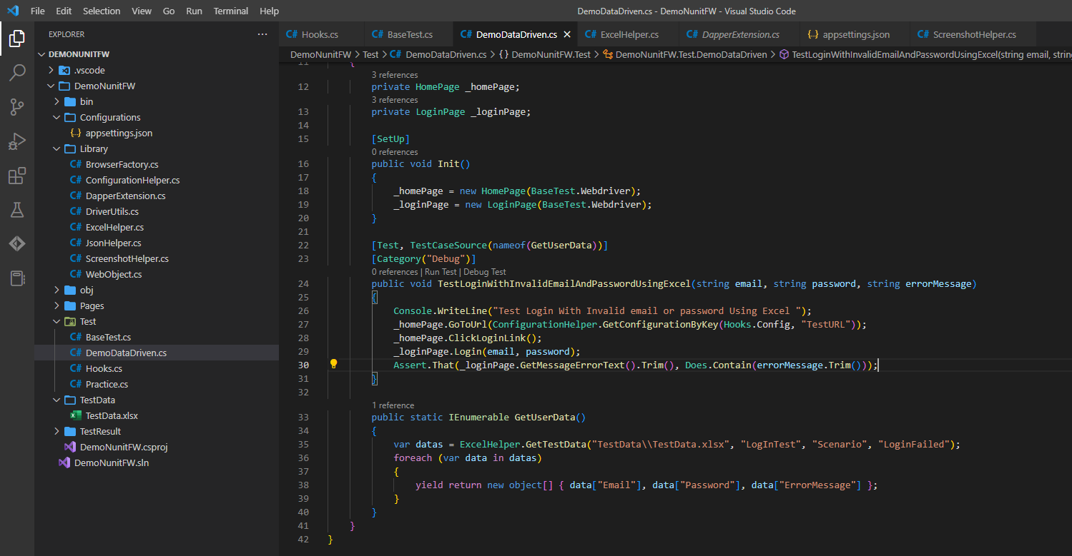
Integrate with TestCaseSource attribute

Slide 38
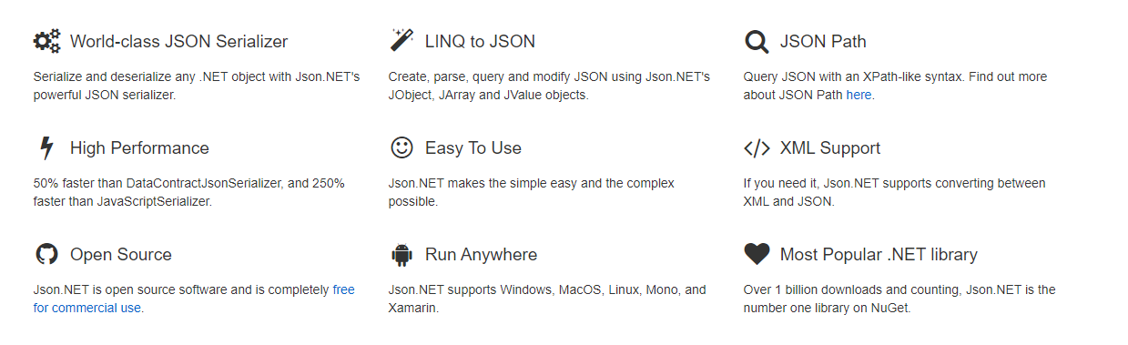
Selenium Data-Driven Testing Using Json
What is Newtonsoft.Json?
Json.NET is a popular high-performance JSON framework for .NET
The Newtonsoft.JSON namespace provides classes that are used to implement the core services of the framework. It provides methods for converting between .NET types and JSON types.
Reference: https://www.nuget.org/packages/Newtonsoft.Json/13.0.2-beta2

Slide 39
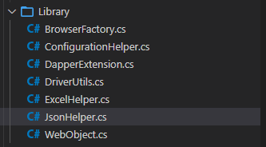
Homework
Create JsonUtil to read JsonFile and then use output to input into your testscript

Slide 40
Extend Report

Slide 41
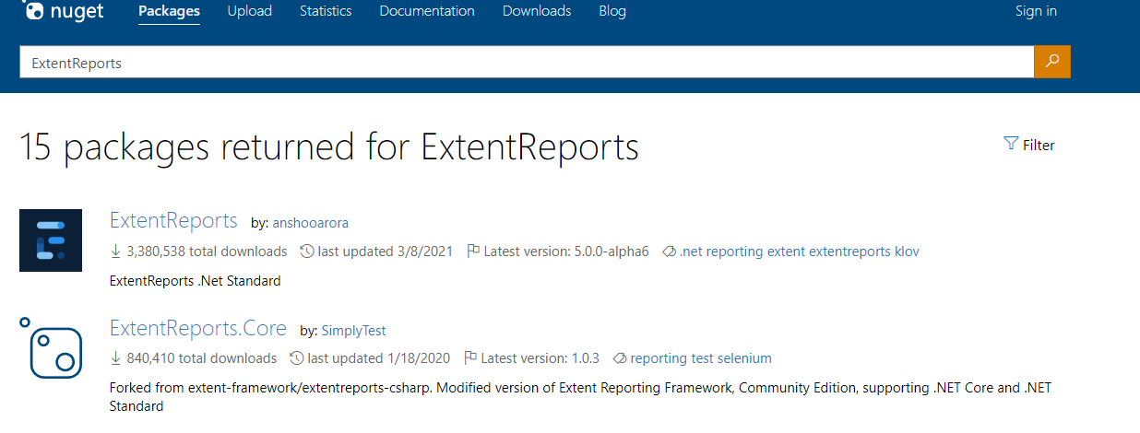
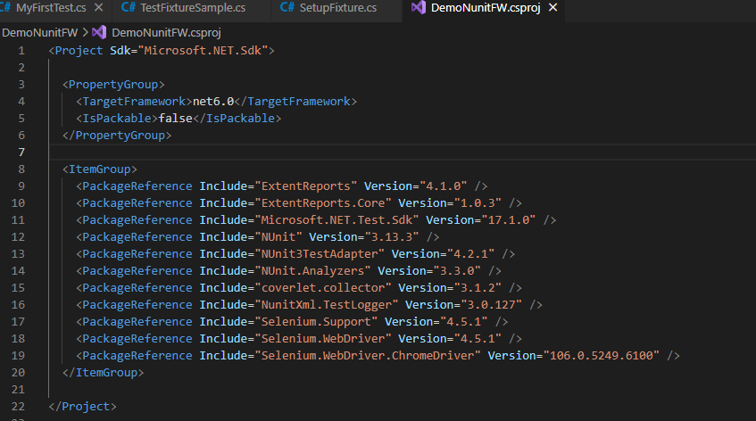
Extend Report
ExtentReports is an open-source reporting library useful for test automation. It can be easily integrated with major testing frameworks like JUnit, NUnit, TestNG, etc. These reports are HTML documents that depict results as pie charts. They also allow the generation of custom logs, snapshots, and other customized details.
Currently, the stable version of Extend Report is v4.1. Therefore, we use this version in this Demo.

Slide 42
Advantages of Extend Report
Easy to setup and integrate ExtentReports with Selenium C# frameworks like NUnit, MSTest, and xUnit and Selenium Java frameworks like TestNG, JUnit, etc.
Helps generate super-customizable HTML test reports that help visualize the status of the tests executed on the Selenium Grid.
Stepwise and Pie-chart representations in the NUnit test report provide top-level information on how the tests have fared (i.e., how many passed/failed) on the execution front.
It lets you customize the report’s look & feel through an XML based configuration file where you can input details such as report theme (Standard/Dark), report title, document title, etc.
It makes it easy to track multiple test cases that are a part of a single test suite.
It can be used with ease even when the test scenarios are executed parallel on a Selenium Grid.
Each test case is accompanied by vital information like logs, results, and the overall time to execute the test.
It lets you capture the ScreenShot with every test step. The captured ScreenShots can help identify the exact step at which the test has failed.

Slide 43
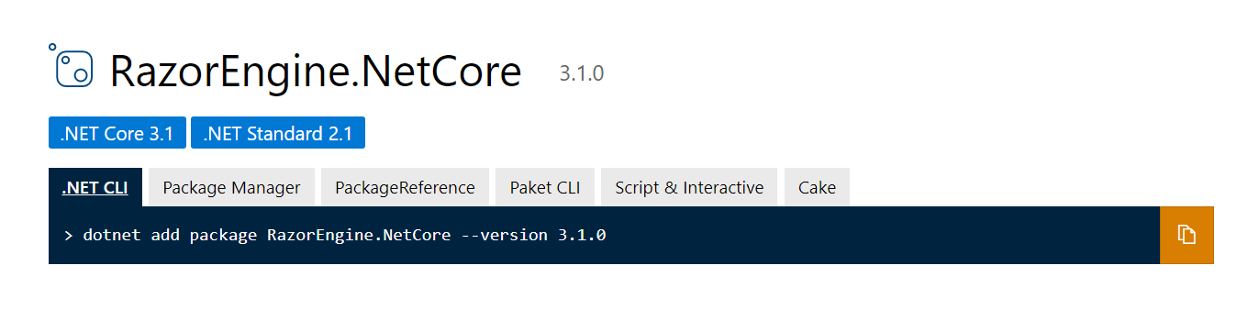
Installation of Extend Report

Slide 44
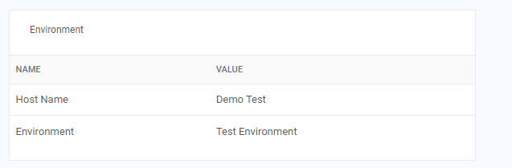
The ‘ExtentReports’ class
The ExtentHtmlReporter class is used for generating Extent Report in the HTML format in the path specified as the argument.
The AttachReporter method of the ExtentReports class is used for attaching the specified reporter
The AddSystemInfo method is used for adding system or environment-related information to the report. This information is automatically added to the started reporters (i.e., ExtentHtmlReporter).
The Flush method writes (or updates) the specified reporter’s test information (i.e., Extent HTML Reporter) to the destination type. In most scenarios, the Flush method should be called only ‘once’ in the [OneTimeTearDown] attribute available in the NUnit framework.
Sample code
var htmlReporter = new ExtentHtmlReporter(reportPath);
var _extent = new ExtentReports();
_extent.AttachReporter(htmlReporter);
_extent.AddSystemInfo("Host Name", "Demo Test");
_extent.AddSystemInfo("Environment", "Test Environment");

Slide 45
The ‘ExtentTest’ Class
The ExtentTest class contains methods for the following tasks:
Creating tests
Creating nodes
Log test steps in the HTML report
Assigning Device Category
Adding Screen Capture from a Base64 String
Adding Screen Capture from a local Path

Slide 46
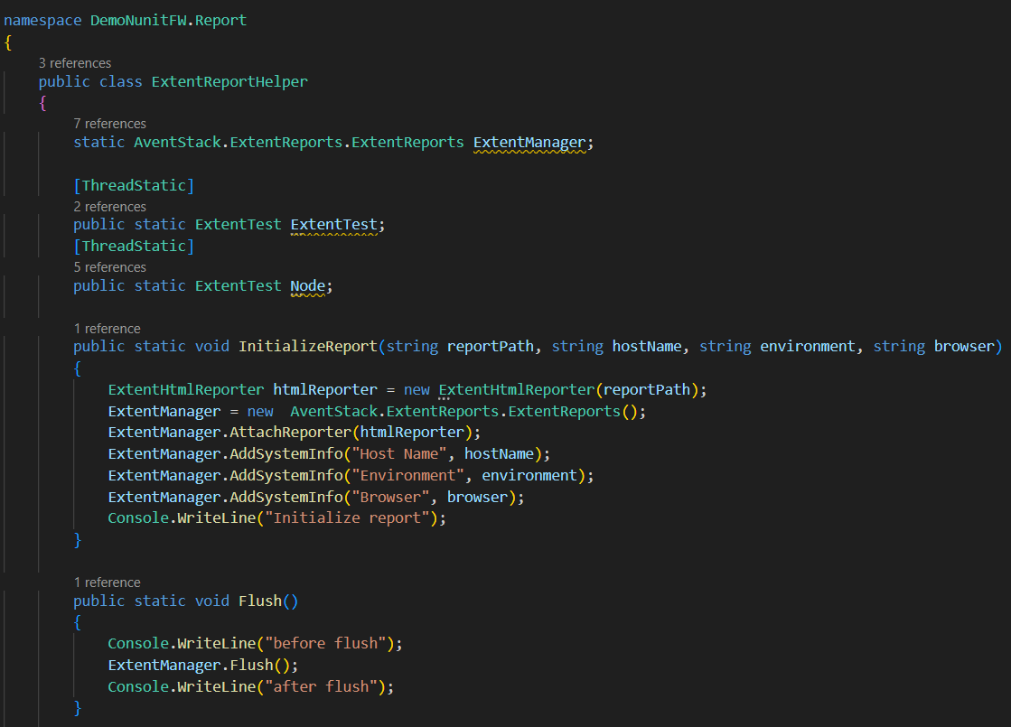
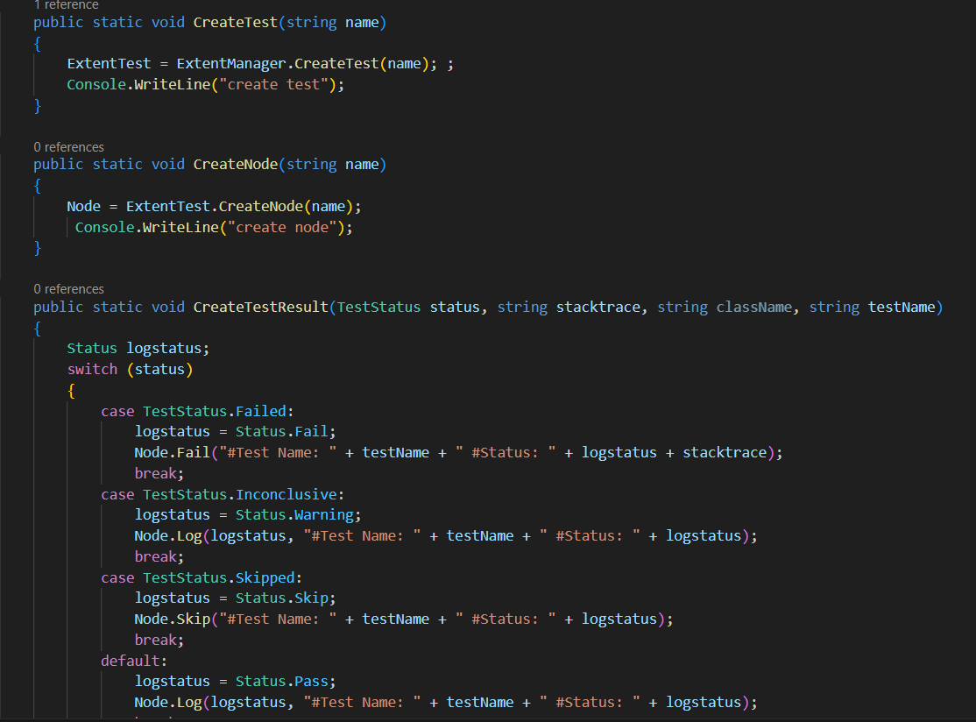
Create the ExtenReportHelper class

Slide 47
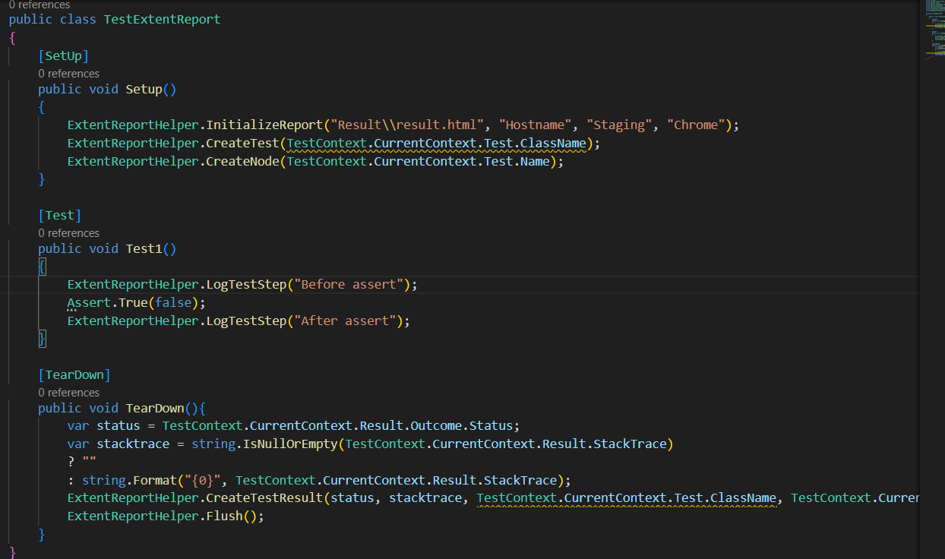
Extent Report Usage

Slide 48
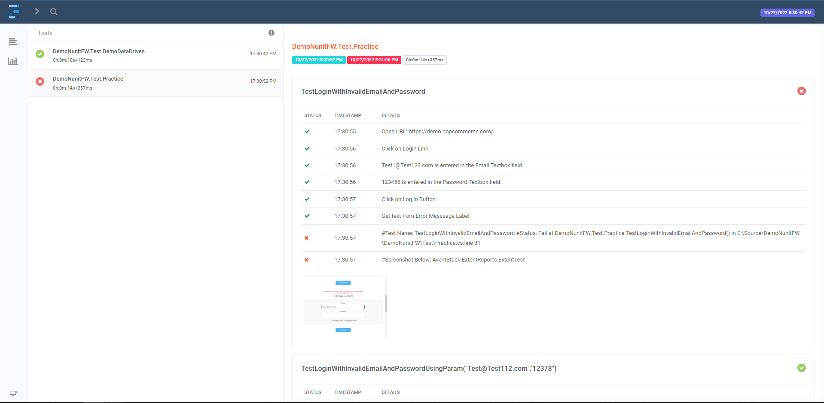
Sample Extend Report

Slide 49



Slide 50
Homework
Implement the below test script
- Test Application: http://192.168.237.10:3000
- Account (User name: Admin2Pass, qp$#tGu^)
Scenario 1: Create new project
Given the user logs into the application
And the user is on Create Project page
When the user fills in all project information
And the user clicks Create button
Then all information of the project is shown.

Slide 51
Homework
Scenario 2: Search project
Given the user logs into the application
And the user is on the Search Project page
When the user applies some search criteria
And the user clicks on Search button
Then all projects matched with input criteria will be displayed.

Slide 52
References
https://www.newtonsoft.com/json
https://github.com/DapperLib/Dapper
https://www.extentreports.com/
https://www.nuget.org/packages/Newtonsoft.Json/13.0.2-beta2
https://docs.nunit.org/articles/nunit/writing-tests/attributes/testcasesource.html

Slide 53
THANK YOU

